Slide 1

N Queens Visualizer
By Anuj Verma

Slide 2
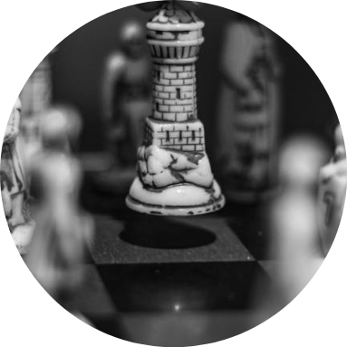
N Queens Problem?
Definition
The N Queens problem involves placing N chess queens on an N×N chessboard so that no two queens attack each other. It's a classic problem in combinatorial optimization and computer science.
Challenge
The main challenge is to find a way to place N queens on the board so that no queen can attack another, considering the horizontal, vertical, and diagonal moves.
Importance
Solving the N Queens problem has implications in various fields like artificial intelligence, algorithms, and computational complexity.

Slide 3
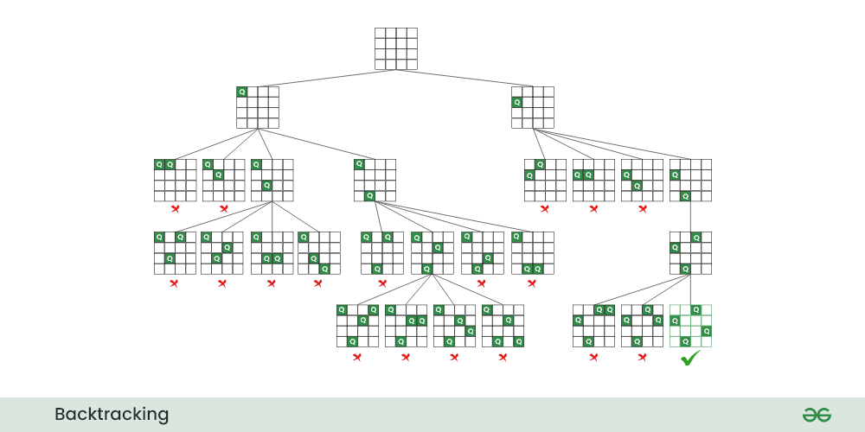
Solving N Queens Problem
Backtracking Algorithm
The idea is to place queens one by one in different columns, starting from the leftmost column. When we place a queen in a column, we check for clashes with already placed queens. In the current column, if we find a row for which there is no clash, we mark this row and column as part of the solution. If we do not find such a row due to clashes, then we backtrack and return false.
findSolution Method
The findSolution method places queens column by column, using isSafe to validate each row. If no valid position is found, it backtracks and tries the next row.
isSafe Method
The isSafe method checks if placing a queen at a specific position is safe by ensuring no queens are in the same row, column, or diagonal, returning true if safe and false otherwise

Slide 4
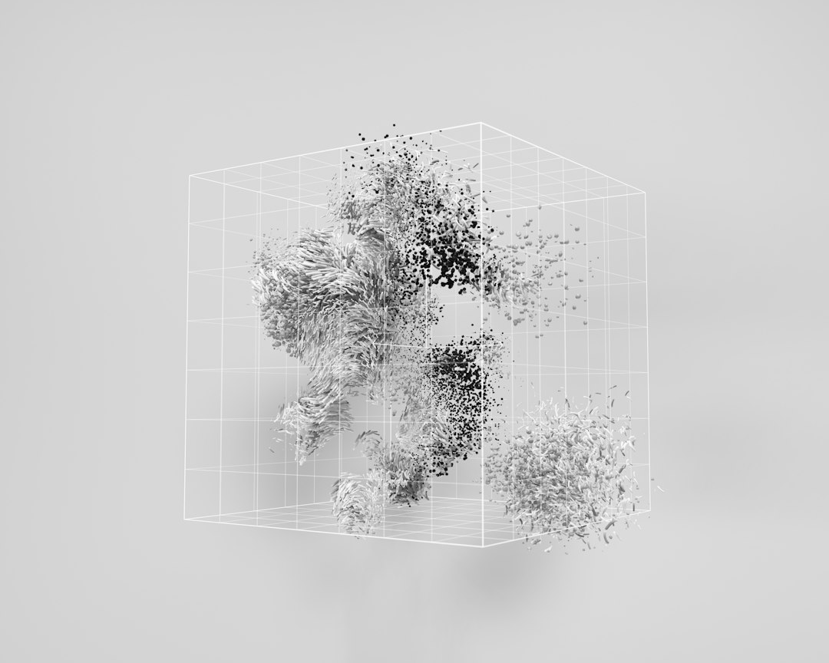
Visualization Technique
Importance of Visualization
Visualization techniques help in understanding the placement of queens on the chessboard effectively. Visual aids enhance problem-solving strategies.
Tools
Utilize tools like Java Swing for GUI creation, allowing visual representation of the chessboard and queen placements, and ImageIO for loading and displaying the queen image on the GUI.
Interactive Visualizers
Develop interactive visualizers that allow users to interact with the solution, making the problem-solving process engaging and educational.
Photos provided by Unsplash

Slide 5
Algorithm Performance Comparison
40%
30%
20%
Backtracking Algorithm
Genetic Algorithm
Constraint Satisfaction Algorithm
Backtracking algorithm's efficiency in solving the N Queens problem accounts for 40% of the total performance.
Genetic algorithm's efficiency in solving the N Queens problem represents 30% of the overall algorithm performance.
Constraint satisfaction algorithm's efficiency accounts for 20% of the total algorithm performance in solving the N Queens problem.

Slide 6
4
Visualization of N Queens Solutions
Board Size | Solution Count
4x4 | 2
5x5 | 10
6x6 | 4
8x8 | 92

Slide 7

Real-World Applications
Artificial Intelligence
Game Development
In AI, the N Queens problem helps in developing intelligent systems, constraint programming, and designing efficient algorithms.
In game development, the problem is used to create challenging levels, AI opponent strategies, and board game simulations.
Education
In educational contexts, the N Queens problem serves as a teaching tool for algorithms, problem-solving, and logic reasoning.

Slide 8

Conclusion and Next Steps
Summary
The N Queens problem is a challenging puzzle with practical applications in AI, game development, and education. Various algorithms offer different performance efficiencies in solving the problem.
Insights
By visualizing the problem and comparing algorithm performance, researchers can enhance their understanding and optimization strategies.
Future Research
Further exploration can focus on parallel processing, hybrid algorithms, and applying the N Queens problem to dynamic environments for advanced solutions.
Photos provided by Unsplash

